Slide 1
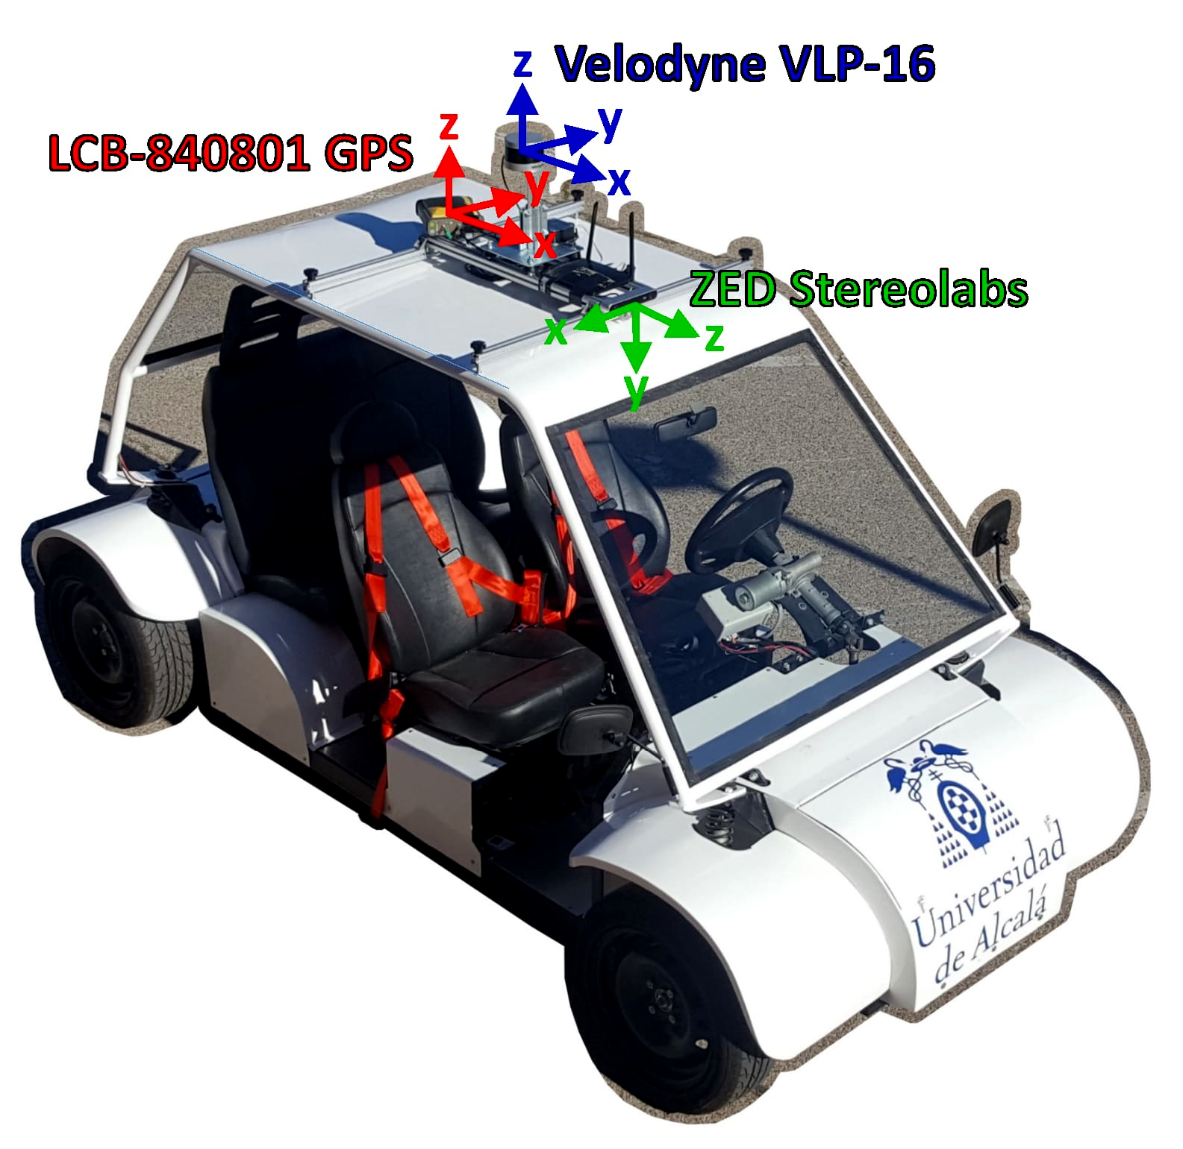
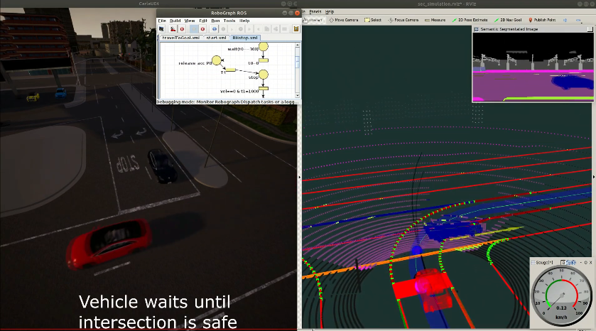


Presentation of Carlos Gómez Huélamo
RobeSafe research group (University of Alcalá, Spain)
by Carlos Gómez Huélamo - Universidad de Alcalá (Spain)

Slide 2
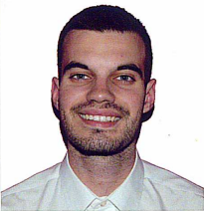
Introduction (Who am I)
My name is Carlos Gómez Huélamo,
PhD Student in AI & Robotics in the
RobeSafe research group (Electronics department, UAH)
(https://www.robesafe.uah.es/index.php/es-es/10-home)
Supervisors: Prof. Luis Miguel Bergasa and Prof. Rafael Barea Navarro
PhD title: “Deep Learning based Multi-Object Tracking, Sensor Fusion and Motion Forecasting for Intelligent Vehicles applications”
Previous studies:
BSc degree in Industrial Electronics and Automation Engineering (Top 3 students, Erasmus+ scholarship in Cork, Ireland)
MSc degree in Industrial Engineering, focused on Robotics & Perception (Top 2 students, Erasmus+ scholarship in Tampere, Finland)
Websites:
LinkedIn: https://www.linkedin.com/in/carlos-g%C3%B3mez-hu%C3%A9lamo/
GitHub: https://github.com/Cram3r95
Notes:
My name is Carlos Gómez Huélamo, currently PhD candidate in Artificial Intelligence and Robotics at the RobeSafe research group (Electronics Department, University of Alcalá) under the supervision of Prof. Luis Miguel Bergasa and Prof. Rafael Barea Navarro. In particular, my PhD thesis is focused on "Deep Learning based Multi-Object Tracking, Sensor Fusion and Motion Forecasting for Intelligent Vehicles applications". I received my BSc degree in Industrial Electronics and Automation Engineering (Top 3 students) from the University of Alcalá (2013-2017) , in which I was granted with an Erasmus+ scholarship to study in the University College of Cork (UCC, Ireland) and my MSc in Industrial Engineering (Top 2 students) from the University of Alcalá (2017-2019), in which I was granted with an Erasmus+ scholarship to study in the Tampere University of Technology (TUT, Finland).

Slide 3
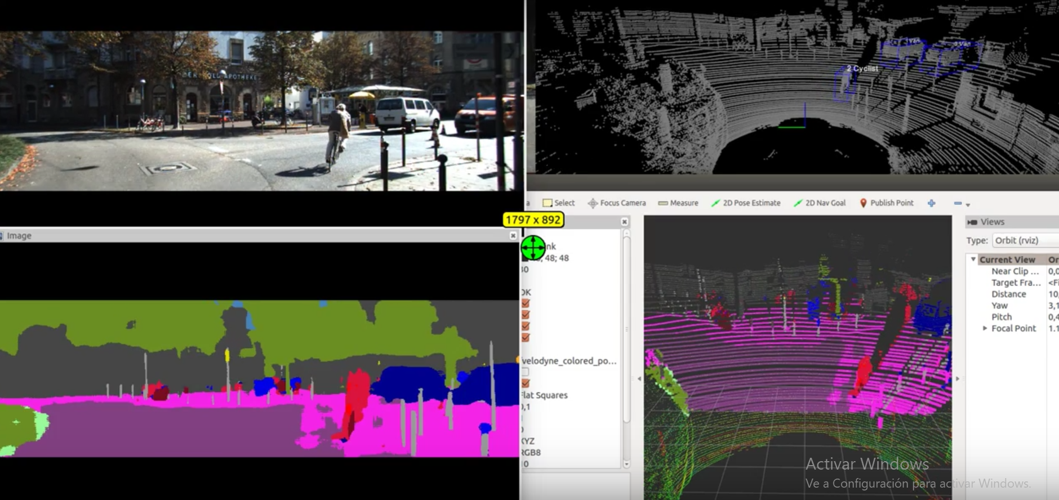
Research topics
Research interest of my group:
Multi-sensorial perception
Location
Navigation
Path planning and mapping
SLAM (Simultaneous Localization and Mapping)
Human-robot interfaces
My specific areas of interest:
Computer Vision
ML/DL
Robotics
Embedded Systems
Intelligent Vehicles
Sensor Fusion
Tracking
Trajectory Prediction
Notes:
Our group conducts exhaustive research on Perception Systems applied to the fields of Service Robotics and e-Safety. Our research interest includes the following techniques for the Service Robotics field: - Multi-sensorial perception - Location - Navigation - Path planning and mapping - SLAM (Simultaneous Localization and Mapping) - Human-robot interfaces. Regarding eSafety field, we are interested in driver behaviors and scene understanding using Computer Vision, Robotic frameworks and Deep Learning techniques for intelligent vehicle applications. Main areas of interest consist of Computer Vision, Machine Learning, Deep Learning, Robotics, Embedded Systems and any field related to these.

Slide 4
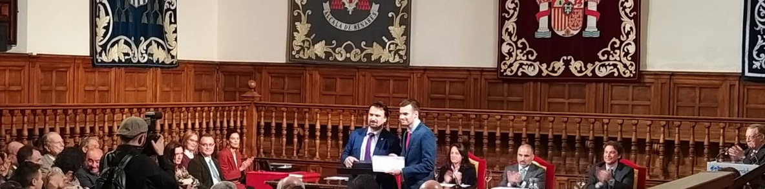
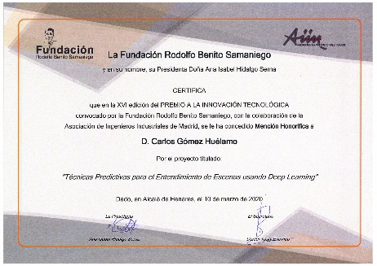
Highlighted awards (Personal)
PhD internship at Karslruhe Institute of Technology (KIT)
(January 2021 – April 2021)
First Prize award (Master's thesis category) in the “2020 Awards – Campus of International Excellence: Bioenergy & Smart Cities”
Honorable Mention in the XVI Edition of the contest “Technological Innovation Award" (2019)
4 years scholarship (FPI-UAH) to course the PhD - 2019/2023
Second Prize award in “Best BSc in Industrial Engineering in the Community of Madrid“ (2017)
Best BSc thesis in Industrial Engineering of Guadalajara (2017)

Slide 5
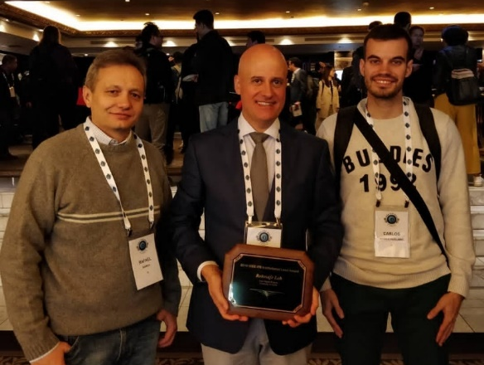
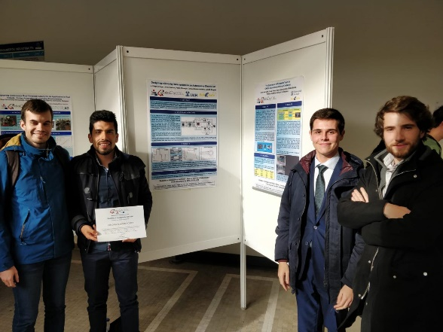
Highlighted awards (Collective)
Best Presentation Award
(Workshop of Physical Agents – Alcalá de Henares, Spain, 2020)
First Prize award in the I Short Video Contest “Why be an Industrial Engineer?” (Escuela Politécnica Superior - University of Alcalá, UAH, 2020)
Institutional Leadership Award from the IEEE Intelligent Transport Systems Society (Auckland, New Zealand, 2019)
Best Poster Award (Robocity 2030 workshop - Madrid, Spain, 2019)
Expert Jury Prize in the Entrepreneurship Contest (“Tu idea en un minuto”) (Alcalá de Henares, Spain, 2016)

Slide 6




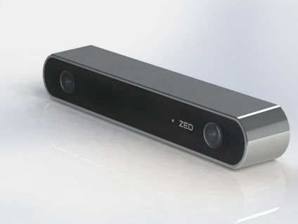
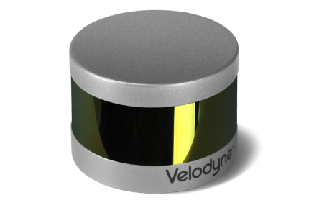

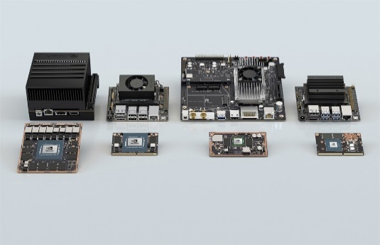


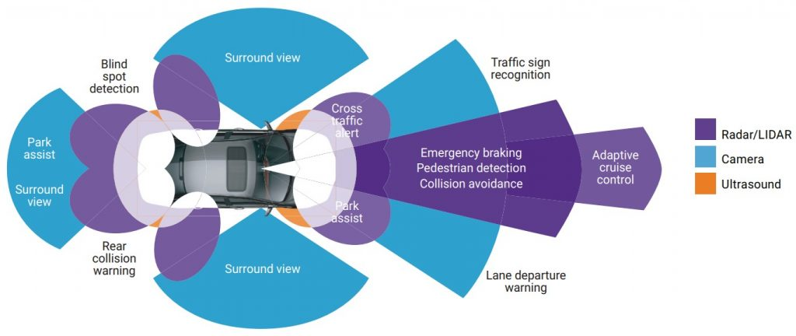


Technical Background

Slide 7
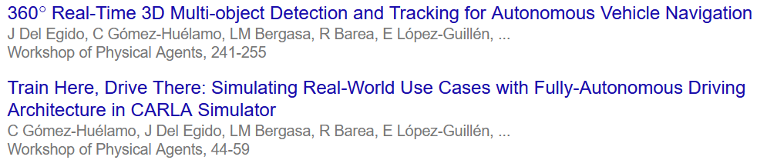
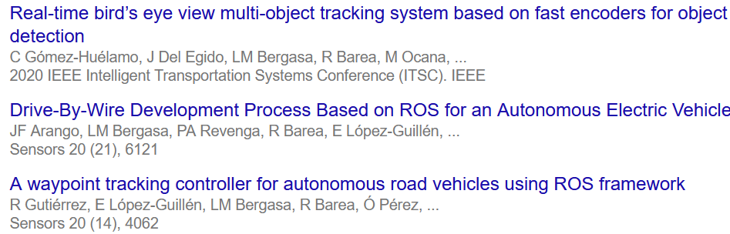
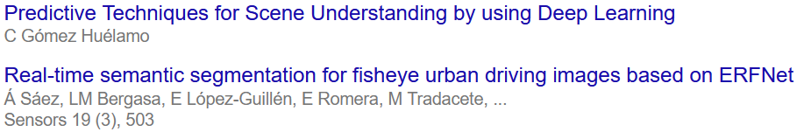
Main Publications
Google Scholar:
https://scholar.google.es/citations?user=OWwoG6EAAAAJ&hl=es
Best Presentation Award
(WAF 2020)
Best Presentation Award finalist
(WAF 2020)
Journal Q1
Journal Q1
Journal Q1

Slide 8
Current literature and interests
Detection:
Vehicle Detection from 3D Lidar Using Fully Convolutional Network (Baidu Research)
RadarNet: Exploiting Radar for Robust Perceptionof Dynamic Objects (University of Toronto)
Expandable YOLO: 3D Object Detection from RGB-D Images (University of Amsterdam)
Tracking:
Probabilistic 3D Multi-Object Tracking for Autonomous Driving (Carnegie Mellon University University)
3D Traffic Scene Understanding from Movable Platforms Prediction (Karlsruhe Institute of Technology)
How To Train Your Deep Multi-Object Tracker (Technical University of Munich)
Fully Convolutional Online Tracking (Nanjing University)
Ocean Object-aware Anchor-free Tracking (Microsoft research)
GNN3DMOT: Graph Neural Network for 3D Multi-Object Tracking with 2D-3D Multi-Feature Learning (Carnegie Mellon University)
AutoSelect: Automatic and Dynamic Detection Selection for 3D Multi-Object Tracking (Carnegie Mellon University)
Prediction (Motion Forecasting)
Generic Tracking and Probabilistic Prediction Framework and Its Application in Autonomous Driving (University of California, Berkeley)
End-to-End 3D Multi-Object Tracking and Trajectory Forecasting (Carnegie Mellon University)
Parallelized 3D Tracking and Forecasting with Graph Neural Networksand Diversity Sampling (Carnegie Mellon Univesity)
Multi-Modal Trajectory Prediction of Surrounding Vehicles with Maneuver based LSTMs (University of California, San Diego)
Prediction-Based Reachability for Collision Avoidance in Autonomous Driving (University of California, Berkeley)
Sensor Fusion:
Fusing Bird’s Eye View LIDAR Point Cloud and Front View Camera Image for 3D Object Detection (University of California, Berkeley)
Real-Time Vehicle Detection Framework Based on the Fusion of LiDAR and Camera (Chang’an University)

Slide 9

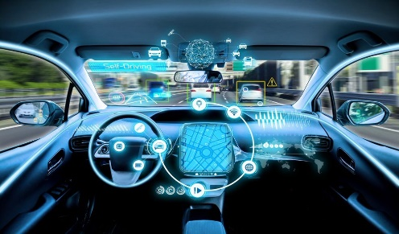
Co-supervised students
MSc students:
Alejandro Díaz Díaz
Thesis: “Automatic generation of HDMaps using Perception algorithms for Intelligent Vehicles applications”
BSc students:
Santiago Montiel Marín
Thesis: “Multi-Object Tracking based on LiDAR and RADAR for Intelligent Vehicles applications”
Miguel Antunes García:
Thesis: “Sistema de Visión estéreo aplicado a la detección y seguimiento de objetos en conducción autónoma”
Javier de la Peña
Thesis: “Algoritmos de detección de objetos 3D basados en LiDAR: comparación entre técnicas pcl clásicas y Deep Learning”

Slide 10
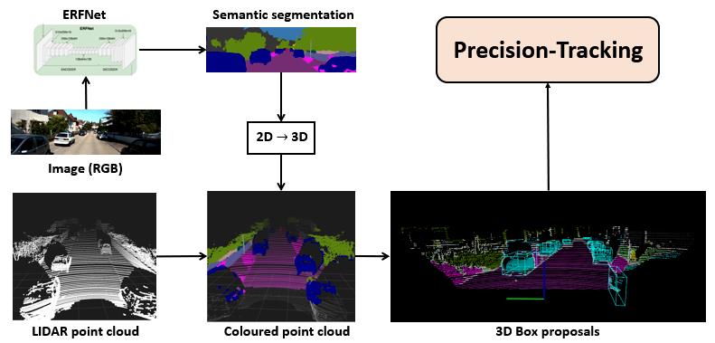
Perception Layer - Strategy I
Notes:
This slide shows the perception strategy of our vehicle. In particular this workflow illustrates how precisión-tracking method is performed in the real world by segmentating the input RGB image using the ERFNet, then fusing the LiDAR point cloud data and 3D transformed Semantic segmentation image in order to obtain a coloured point cloud. Finally, by using this coloured point cloud, we can extract the main relevant clusters so as to carry out the precisión-tracking algorithm. In the case of simulation, the process is exactly the same but the ERFNet is not applied since we define in V-REP the objects in a single color as they are segmentated.

Slide 11
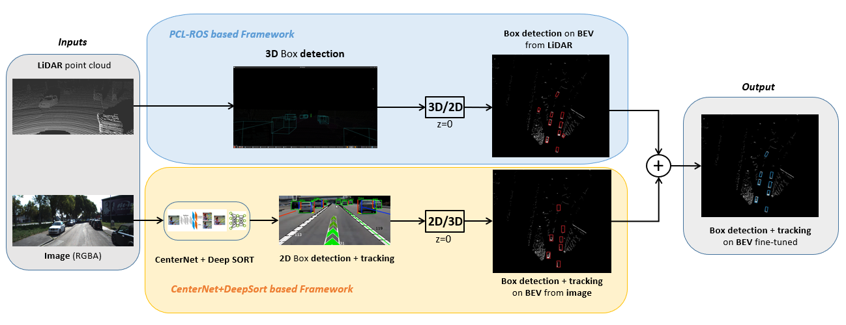
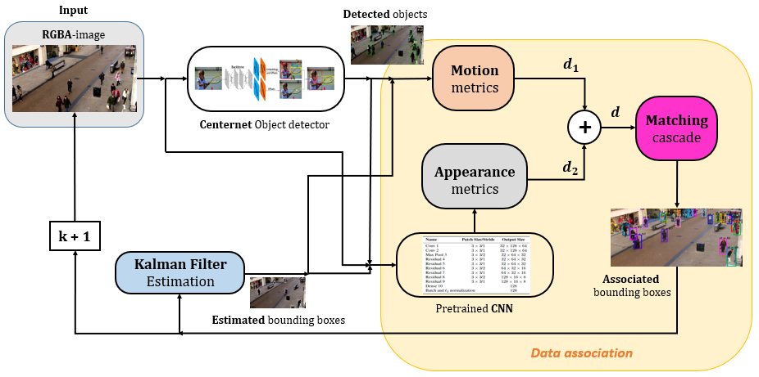
Perception Layer - Strategy II

Slide 12


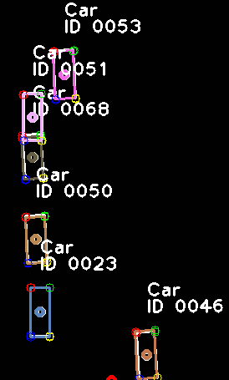
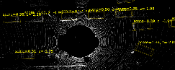
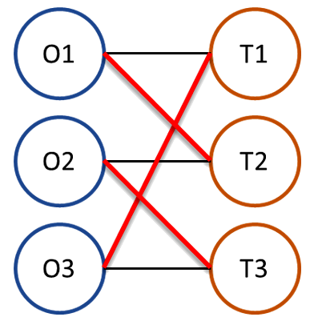
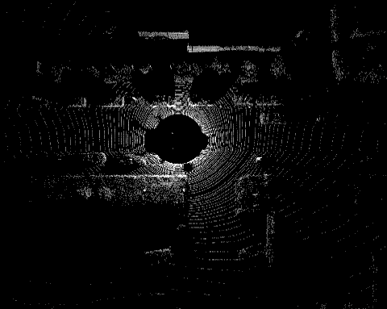
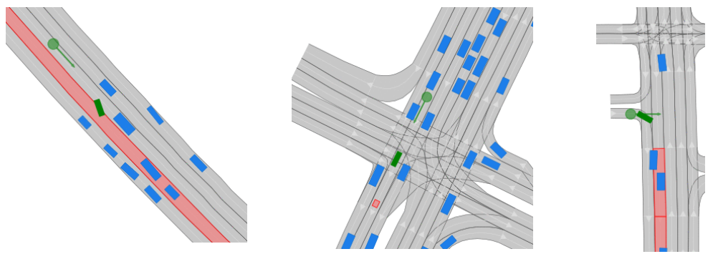

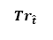
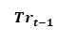
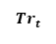
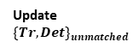
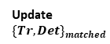
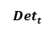
Perception Layer – Strategy III
Detection module
Tracking module
Output (Tracked objects)
Data Association^{[2]}
3D Object Detection^{[5]}
$${Det}_{t}$$
t
$${Tr}_{\hat{t}}$$
$${Tr}_{t−1}$$
BEV Kalman Filter
Update $\{Tr,Det\}_{unmatched}$
B/D Memory
Update $\{Tr,Det\}_{matched}$
$${Tr}_{t}$$
Matched Trackers
Create/Delete Tracker
Input (LiDAR point cloud)

Slide 13


